Slide 1
Selecting new restaurant location by comparing neighborhoods.
Seethalakshmy Parameswaran

Slide 2

The Analysis is to compare Dublin and New Albany as Potential locations for a new restaurant
Population – Current
Population growth estimate for future
Household income in each area
Demographic makeup of the population
Restaurant to population ratio and modeling
Predicting which would be better location.

Slide 3
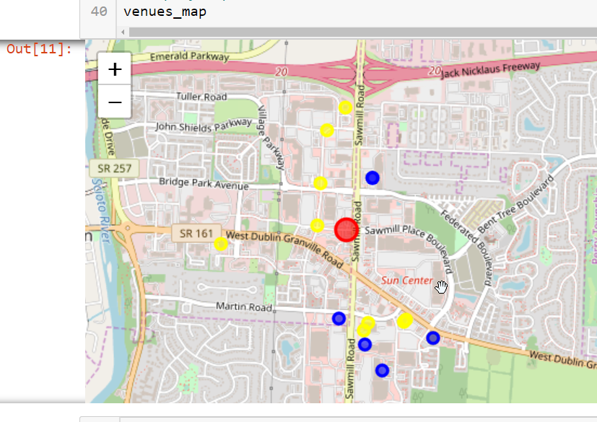
Dublin has 7 restaurants based on foursquare data.

Slide 4
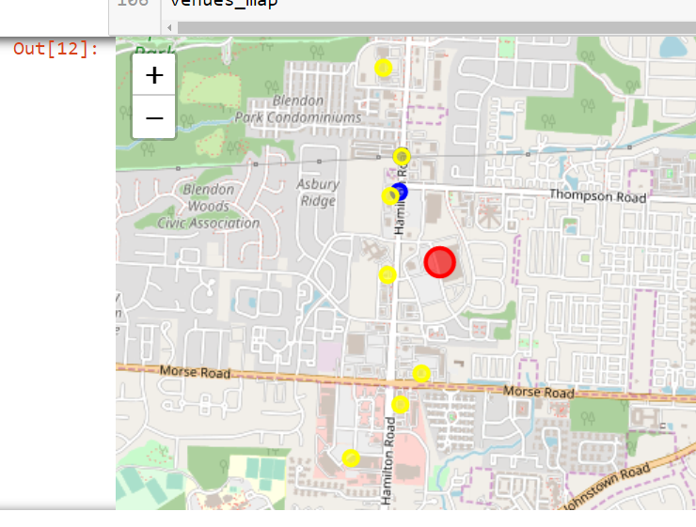
New Albany has one restaurants based on foursquare data.

Slide 5
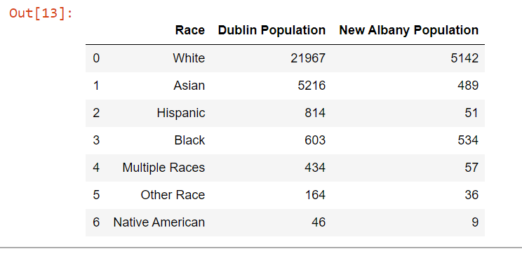

Demographics Details by Area

Slide 6
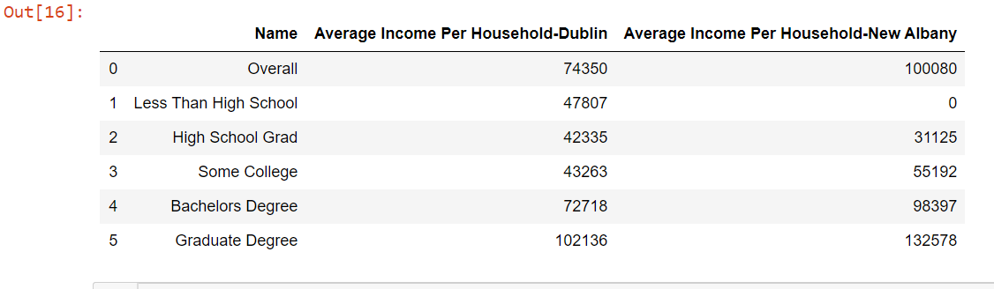

Household Income by Education by Area

Slide 7
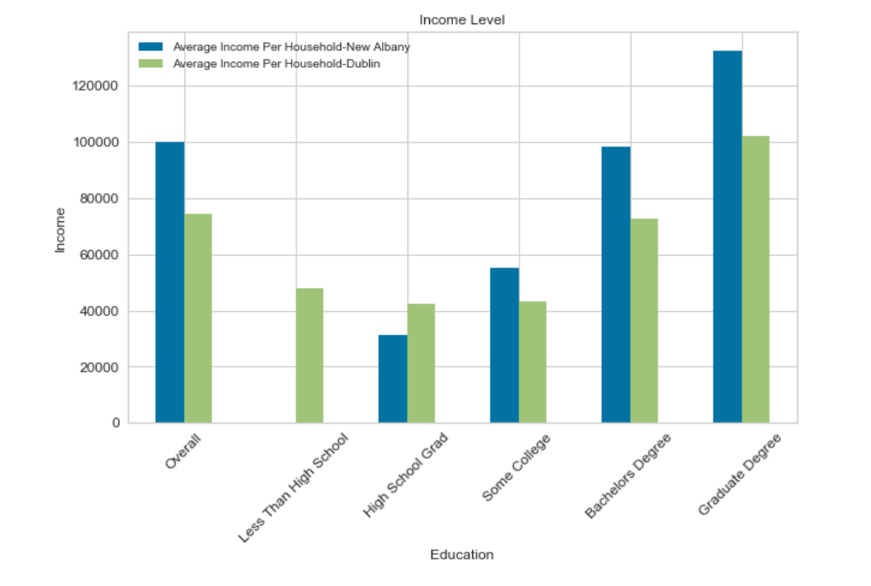
New Albany has higher spend potential than Dublin

Slide 8
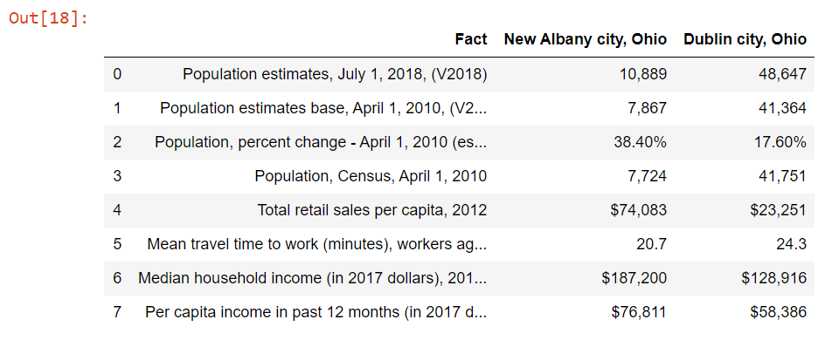

New Albany has a faster growing population of Asians as well as higher spending and earning.

Slide 9
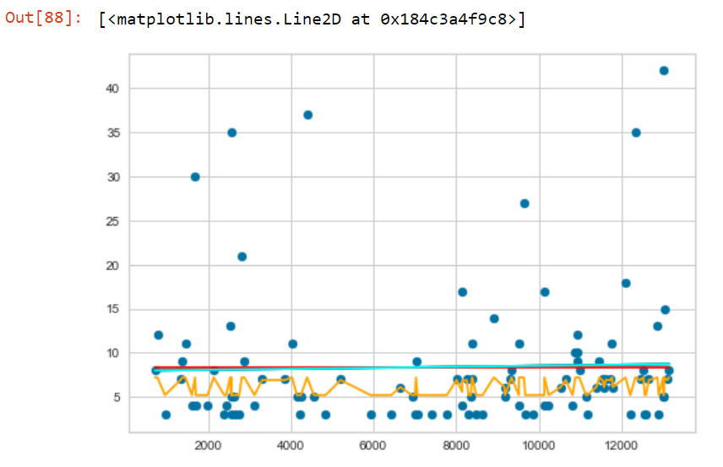
Plot of similar neighborhoods against the number of Indian restaurants that serve the area

Slide 10

CONCLUSION
My recommendation would be to start off the restaurant in New Albany as compared to Dublin because of various major factors like the ratio of people to restaurants, the lack of many similar cuisines In New Albany, the average spending pattern/power of the New Albany Residents and relatively growing population since New Albany is only an up and coming village compared to the already established city of Dublin.

